Slide 1
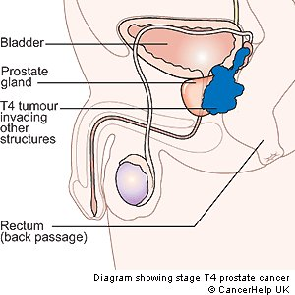
Prostate Cancer

Slide 2
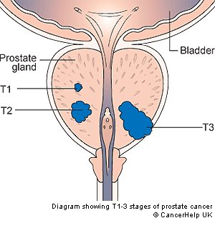
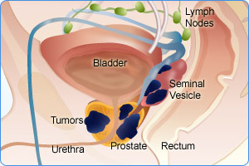
Staging Cancer
Staging Prostate Cancer
Tx | Primary tumor cannot be assessed.
T1 | Tumor is too small to be seen/felt
T2 | Tumor is inside the prostate
T3 | Tumor has broken through the capsule of the prostate
T4 | Tumor has spread into other organs nearby
Staging Lymph Node
NX | Lymph not cannot be checked
N0 | No cancer cells in lymph nodes close to prostate
N1, N2 and N3 | Cancer cells present in lymph nodes
Staging Metastasis
M0 | No metastasis: Cancer has no spread beyond lymph
M1 | Metastasis: cancer move to other organs
Notes:
So, a cancer described as T2 N0 M0 is
A cancer that is entirely within the prostate
With no cancer spread to lymph nodes
And no spread of the cancer to areas outside the pelvis

Slide 3
Example of Staging | Meaning
T2 N0 M0 | A cancer that is entirely within the prostate With no cancer spread to lymph nodes And no spread of the cancer to areas outside the pelvis
Tx Nx M1 | Primary tumor cannot be assessed Lymph not cannot be checked Cancer has moved to other organs
Tx N1, N2 and N3 | Primary tumor cannot be assessed Cancer spread to lymph nodes
T4 N0 | Tumor has spread into other organs With no cancer spread to lymph nodes
http://www.cancerresearchuk.org/cancer-help/type/prostate-cancer/treatment/the-stages-of-prostate-cancer
Notes:
So, a cancer described as T2 N0 M0 is
A cancer that is entirely within the prostate
With no cancer spread to lymph nodes
And no spread of the cancer to areas outside the pelvis

Slide 4
Prostate Cancer Prevention: Finasteride
Prostate Cancer Treatment
Tx Nx M1
Tx N1, N2 and N3
T3
or
T4 N0
Treat with:
Hormone Therapy
Treat with:
Hormone +/- Radio
Treat with:
Hormone
Or
Radiotherapy
Or
Radio + Hormone
Notes:
radiotherapy used in cancer treatment

Slide 5
Hormone Therapy: LHRH Analog
MOA: Increase LH and FSH causing a negative feedback → inhibiting gonadotropin secretion
LHRH Analog | Dose |  | Side Effect: Bone Loss
Goserelin | 3.6 mg monthly or 10.8 mg q3 months | + | Calcium + Vit D (consider bisphosphonates)
Leuprolide | 7.5 mg monthly or 22.5 mg q3 months or 30 mg q4 months | + | Calcium + Vit D (consider bisphosphonates)
Hormone Therapy: Anti-Androgens
MOA: Androgen receptor antagonist
Anti-Androgen | Dose
Bicalutamide | 50 mg PO daily
Nilutamide | 150 mg PO daily
Flutamide | 250 mg PO q8h

Slide 6
Salvage Therapy
Androgen withdrawal (stop the Casodex)
Surgical orchiectomy
Androgen synthesis inhibitors – Ketoconazole or Abiraterone (with prednisone)
Chemotherapy
Docetaxel + prednisone (OS benefit)
Cabazitaxel + prednisone (OS benefit)
Mitoxantrone + prednisone (palliative only)
Immunotherapy
Sipuleucel T

